Slide 1
The Next Release Problem
Team Members:
1) Pritesh Ranjan (pranjan)
2) Raghavendra Prasad Potluri (rpotlur)
3) Akshay Kumar Chaluvadi (achaluv)

Slide 2
Background
The Search Based Software Engineering (SBSE) field has been benefiting from a number of general search methods, including, but not limited to, Genetic Algorithms, Simulated Annealing, Greedy Search, GRASP and Tabu Search.
As an important Requirement Engineering problem, several strategies have been applied in the attempt to solve the Software Release Planning problem, including Genetic Algorithms and Simulated Annealing.
Surprisingly, even with the large applicability and the significant results obtained by the Ant Colony Optimization (ACO) metaheuristic, very little has been done regarding the employment of this strategy to tackle software engineering problems modeled as optimization problems.

Slide 3
The Problem
Given a software package, there is a set, C, of m customers whose requirements have to be considered in the development of the next release of this system.
There is also a set, R, of n requirements to complete. In order to meet each requirement it is needed to expend a certain amount of resources, which can be transformed into an economical cost: the cost of satisfying the requirement.
We also assume that more than one customer can be concerned with any requirement, and that all the requirements are not equally important for all the customers.

Slide 4
Ant Colony Optimizer
Problem Encoding:
A graph will be generated with the Release Planning problem instance information.
Two types of edges will be created, representing mandatory and optional moves for a particular ant.
Mandatory moves will be created to ensure that precedence constraints are respected.

Slide 5
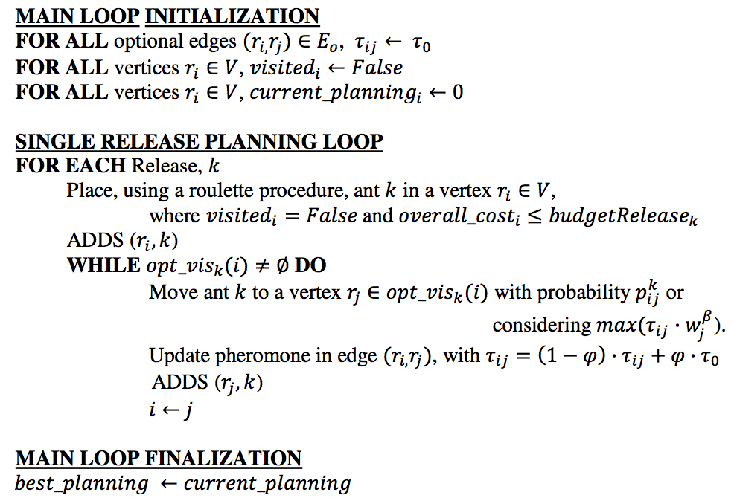
The Algorithm
The overall structure of the ACO Algorithm for the Software Release Planning problem is: each ant will be responsible for iteratively constructing a single release.

Slide 6
The Mandatory Gif
Notes:
http://i.imgur.com/unH0T5O.gif

Slide 7
More on the Algorithm
CDom is used to evaluate better solution.
The proposed constant values are:
ALPHA = 1
BETA = 2
Q = 1
P = 0.1
A roulette procedure, considering the heuristic information measure of a node will be employed to select the initial node of each ant.
ACO returns the best solution, for a given set of input.

Slide 8
NRP model parameters:
Number of Requirements = 30
Number of Clients = 20
Budget = 1000
Objectives:
1. Minimize Cost
2. Maximize Customer Satisfaction
Optimizers:
Genetic Algorithm
Differential Evolution

Slide 9
Genetic Algorithm
Population Size : 300
Generations : 10
Mutation Rate: 0.3
Domination Method: Continuous Domination (CDOM)
Crossover Method:
1. Single Point crossover - First half of one and later half of other
Problem with GA: Almost all the generated children were invalid.
Counter Steps:
Random crossover - One bit from each parent at random
Result:- Reduced the number but not significantly.
Changing Mutation Rate to 0.01:
Result:- Reduced frequency of invalid children to half.

Slide 10
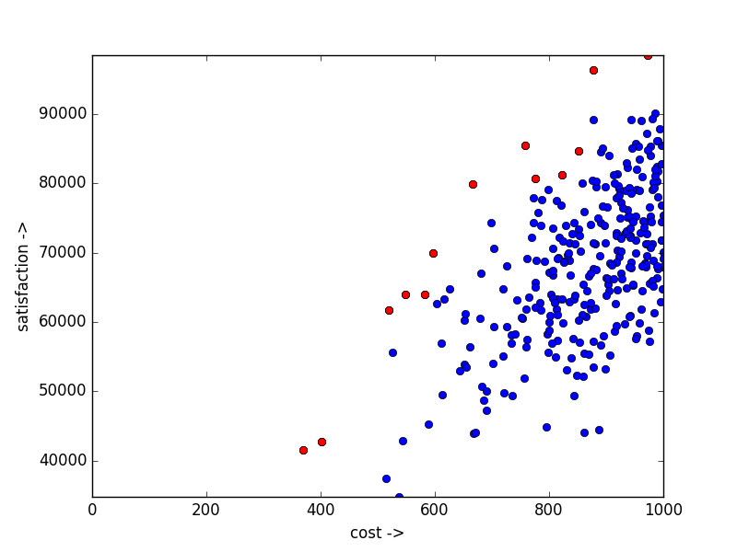
GA plot
GA - with CDOM
Green: Initial Population
Blue: Optimized solutions
Red: Pareto frontier generated by GA
Green is not visible because, blue almost overwrote it.

Slide 11
Differential Evolution
Method: DE/RAND/1
Population Size: 300
F = 0.25
Domination Method: B-Dom and C-Dom
How did we get F?
Maximize the number of better candidates generated.

Slide 12
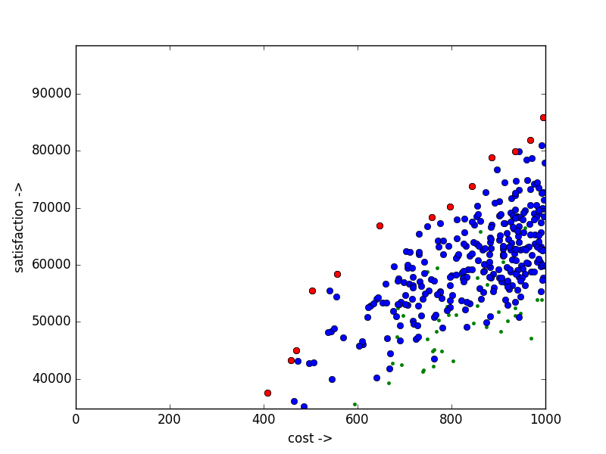
More on G.A
DE - with B-DOM
Green: Initial Population
Blue: Optimized solutions
Red: Pareto frontier generated by DE

Slide 13
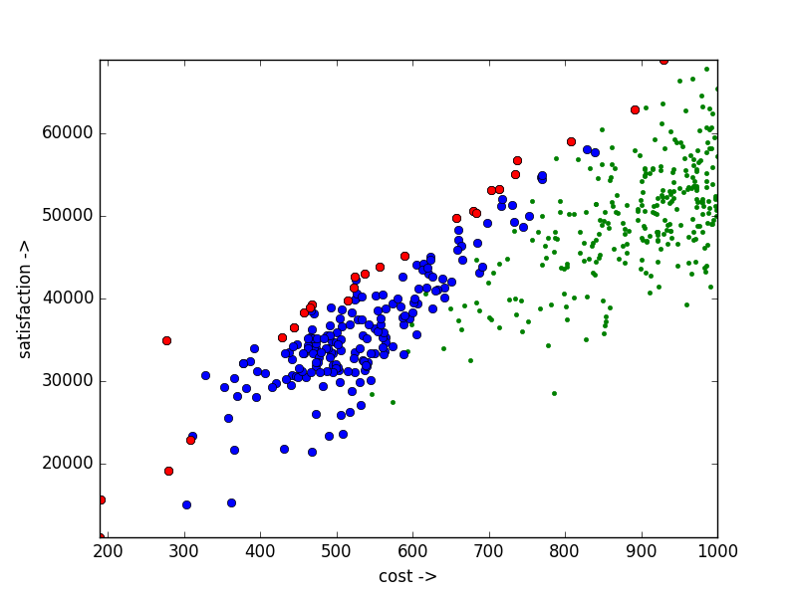
The Results
DE - with CDOM
Green: Initial Population
Blue: Optimized solutions
Red: Pareto frontier generated by DE
Notice the new candidates generated.

Slide 14
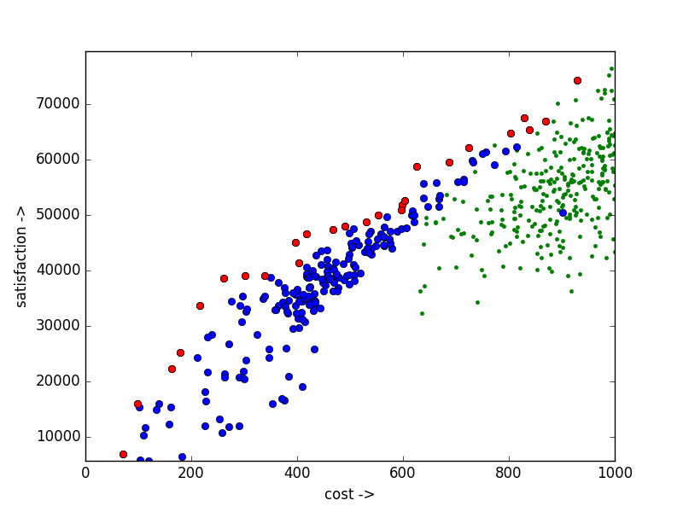
The Results
DE - with CDOM
Green: Initial Population
Blue: Optimized solutions
Red: Pareto frontier generated by DE

Slide 15
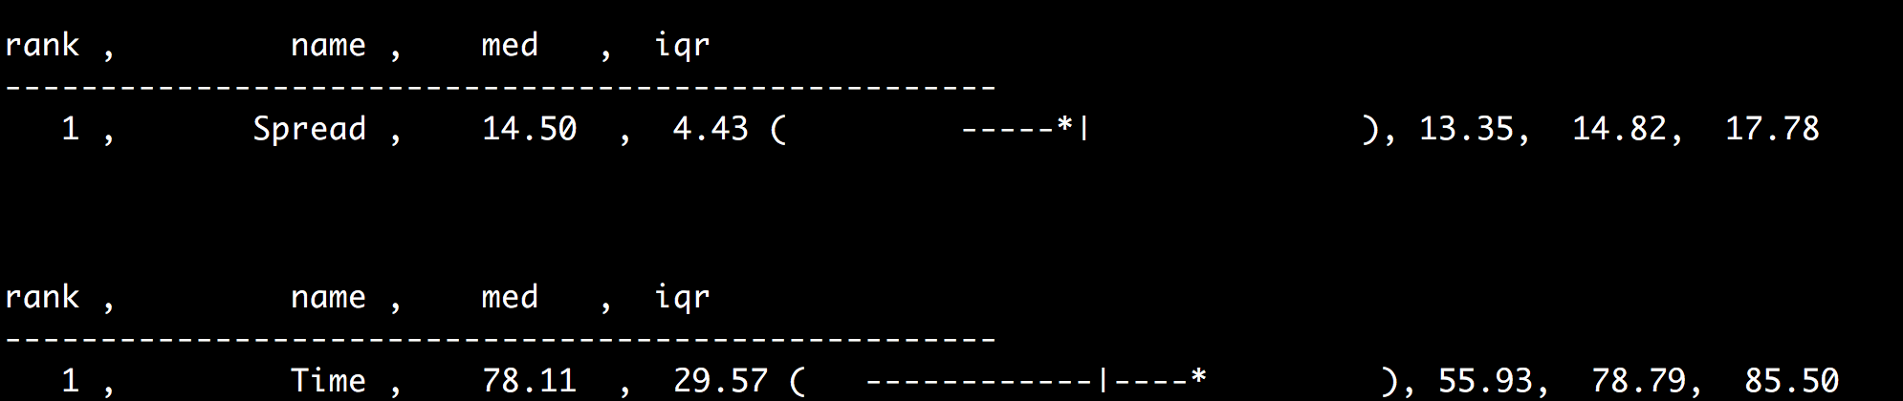
The Results - Genetic Algorithm

Slide 16
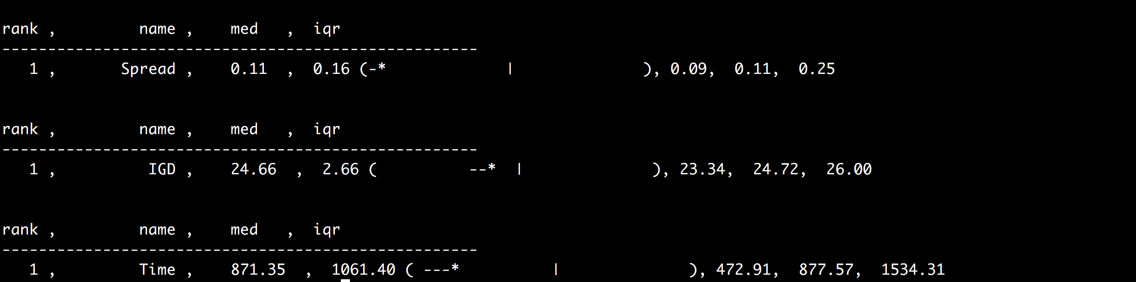
The Results - Differential Evolution

